Slide 1
Relations
Chapter 9

Slide 2
Chapter Summary
Relations and Their Properties
Representing Relations
Equivalence Relations
Partial Orderings

Slide 3
Relations and Their Properties
Section 9.1

Slide 4
Section Summary
Relations and Functions
Properties of Relations
Reflexive Relations
Symmetric Relations
Antisymmetric Relations
Transitive Relations
Irreflexive Relations
Asymmetric Relations
Combining Relations

Slide 5
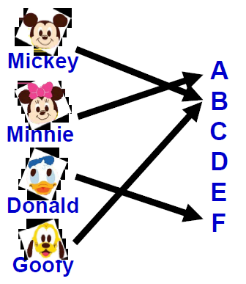
Recall, Function is…
Let A and B be nonempty sets Function f from A to B is an assignment of exactly one element of B to each element of A.
By defining using a relation, a function from A to B contains unique ordered pair (a, b) for every element a ∈ A.

Slide 6
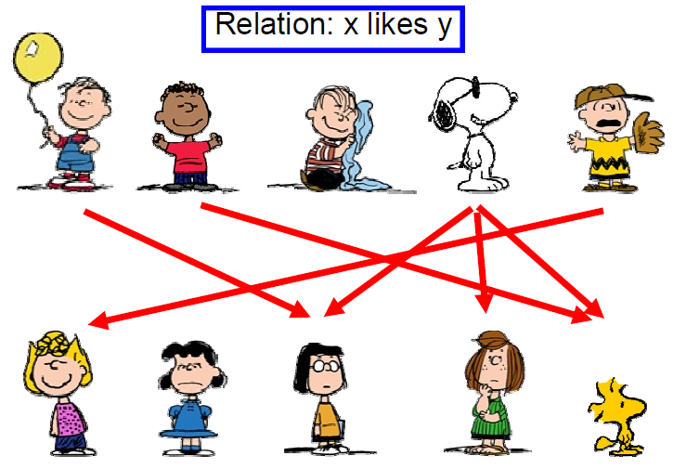
What is Relation?

Slide 7

Binary Relations
Definition: A binary relation R from a set A to a set B is a subset R ⊆ A × B.
Recall, for example:
A = {a1, a2} and B = {b1, b2, b3}
A x B = { (a1, b1), (a1, b2), (a1, b3),
(a2, b1), (a2, b2), (a2, b3)}
Ordered pairs, which
First element comes from A
Second element comes from B
aRb: (a, b) ∈ R
: (a, b) ∉ R
Moreover, when (a, b) belongs to R, a is said to be related to b by R.

Slide 8
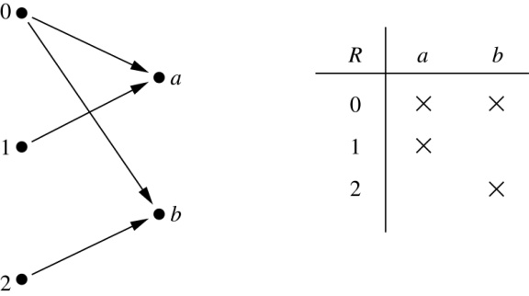
Binary Relations
Example:
Let A = {0,1,2} and B = {a,b}
{(0, a), (0, b), (1,a) , (2, b)} is a relation from A to B.
We can represent relations from a set A to a set B graphically or using a table:

Slide 9
Binary Relations
EXAMPLE:
Let A = {eggs, milk, corn} and B = {cows, goats, hens}
Define a relation R from A to B by (a, b) ∈R iff a is produced by b.
Then R = {(eggs, hens), (milk, cows), (milk, goats)}
Thus, with respect to this relation eggs R hens , milk R cows, etc.

Slide 10
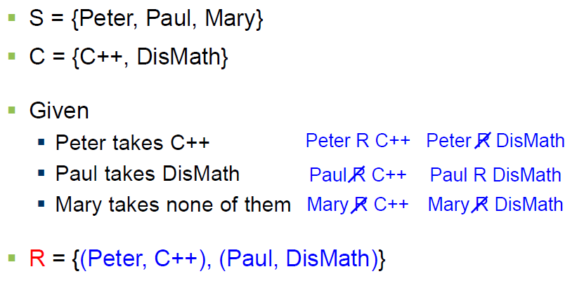
Binary Relations
EXAMPLE #1:

Slide 11
Domain and Range of a Relation
DOMAIN OF A RELATION:
The domain of a relation R from A to B is the set of all first elements of the ordered pairs which belong to R denoted by Dom(R).
Symbolically, Dom (R) = {a ∈A | (a, b) ∈R}
RANGE OF A RELATION:
The range of a relation R from A to B is the set of all second elements of the ordered pairs which belong to R denoted Ran(R).
Symbolically, Ran(R) = {b ∈B | (a, b) ∈ R}

Slide 12
Domain and Range of a Relation
EXERCISE:
Let A = {1, 2}, B = {1, 2, 3},
Define a binary relation R from A to B as follows:
R = {(a, b) ∈A × B | a < b} Then
a. Find the ordered pairs in R.
b. Find the Domain and Range of R.
c. Is 1R3, 2R2?
SOLUTION:
Given A = {1, 2}, B = {1, 2, 3},
A × B = {(1,1), (1,2), (1,3), (2,1), (2,2), (2,3)}
a. R = {(a, b) ∈A × B | a < b}
R = {(1,2), (1,3), (2,3)}

Slide 13
Domain and Range of a Relation
Given A = {1, 2}, B = {1, 2, 3},
A × B = {(1,1), (1,2), (1,3), (2,1), (2,2), (2,3)}
b. Find the Domain and Range of R.
Solution:
Dom(R) = {1,2} and Ran(R) = {2, 3}
c. Is 1R3, 2R2?
Solution:
c. Since (1, 3)∈R so 1R3.
Since (2, 2)∈R so 2R2.

Slide 14
Representing Relations

Slide 15
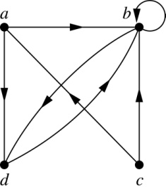
Representing Relations Using Digraphs
Definition: A directed graph, or digraph, consists of a set V of vertices (or nodes) together with a set E of ordered pairs of elements of V called edges (or arcs). The vertex a is called the initial vertex of the edge (a,b), and the vertex b is called the terminal vertex of this edge.
An edge of the form (a,a) is called a loop.
Example: A drawing of the directed graph with vertices a, b, c, and d, and edges (a, b), (a, d), (b, b), (b, d), (c, a), (c, b), and (d, b) is shown here.

Slide 16
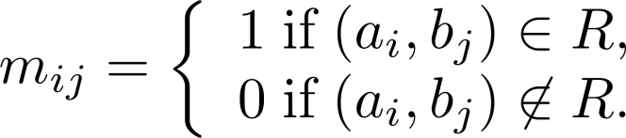
Representing Relations Using Matrices
A relation between finite sets can be represented using a zero-one matrix.
Suppose R is a relation from A = {a₁, a₂, …, a_{m}} to B = {b₁, b₂, …, b_{n}}.
The elements of the two sets can be listed in any particular arbitrary order. When A = B, we use the same ordering.
The relation R is represented by the matrix M_{R} = [m_{ij}], where
The matrix representing R has a 1 as its (i,j) entry when a_{i} is related to b_{j} and a 0 if a_{i} is not related to b_{j}.

Slide 17
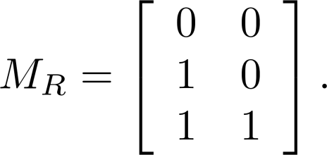
Examples of Representing Relations Using Matrices
Example 1: Suppose that A = {1,2,3} and B = {1,2}. Let R be the relation from A to B containing (a,b) if a ∈ A, b ∈ B, and a > b. What is the matrix representing R (assuming the ordering of elements is the same as the increasing numerical order)?
Solution: Because R = {(2,1), (3,1),(3,2)}, the matrix is

Slide 18
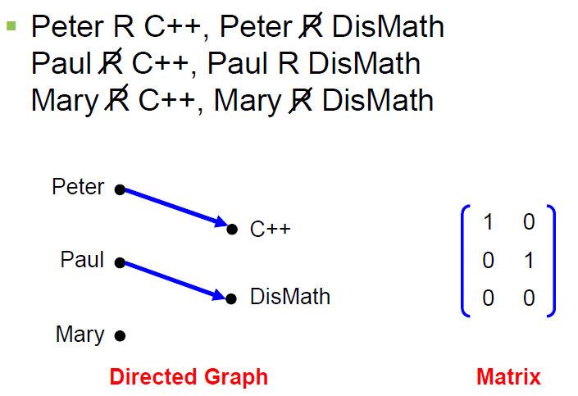
Binary Relations
EXAMPLE #1: (cont.)

Slide 19
Binary Relation on a Set
Definition: A binary relation R on a set A is a subset of A × A or a relation from A to A.
Example:
Suppose that A = {a,b,c}. Then R = {(a,a),(a,b), (a,c)} is a relation on A.
Let A = {1, 2, 3, 4}. The ordered pairs in the relation R = {(a,b) | a divides b} are
{(1,1), (1, 2), (1,3), (1, 4), (2, 2), (2, 4), (3, 3), and (4, 4)}.
REMARK:
For any set A
1. A × A is known as the universal relation.
2. ∅ is known as the empty relation.

Slide 20
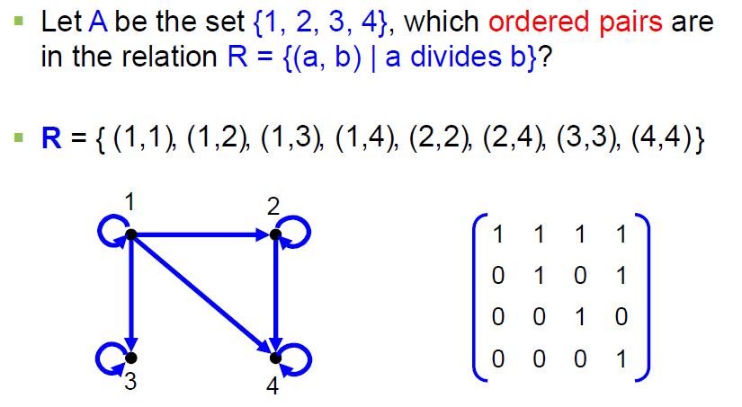
Binary Relation on a Set

Slide 21
Relations and Their Properties

Slide 22
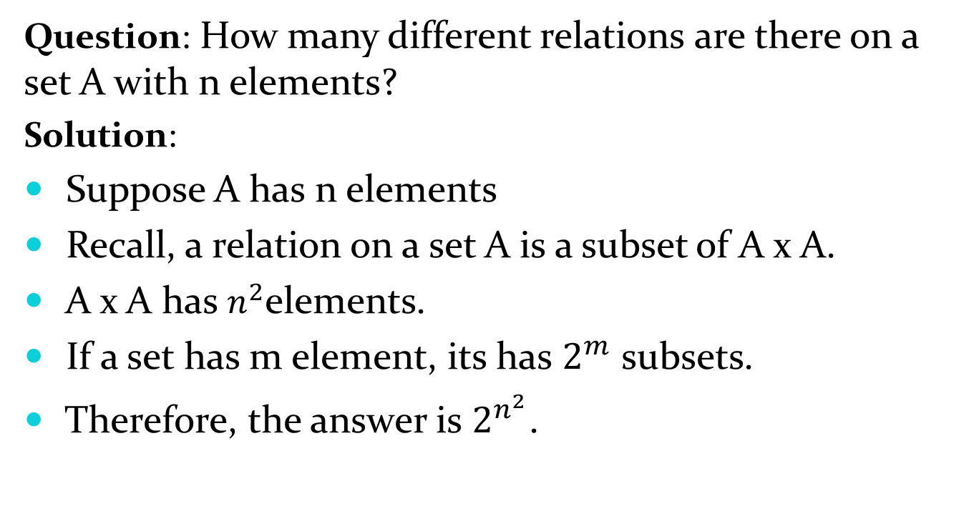
Binary Relation on a Set (cont.)
Question: How many different relations are there on a set A with n elements?
Solution:
Suppose A has n elements
Recall, a relation on a set A is a subset of A x A.
A x A has$n^{2}$elements.
If a set has m element, its has $2^{m}$ subsets.
Therefore, the answer is $2^{n^{2}}$.

Slide 23
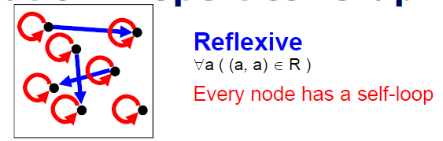
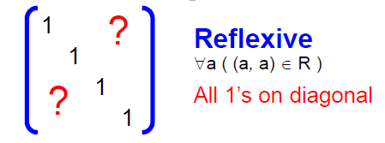
Reflexive Relations
Definition: R is reflexive iff (a,a) ∊ R for every element a ∊ A. Written symbolically, R is reflexive if and only if
∀a[a∊U ⟶ (a,a) ∊ R]
If A = ∅ then the empty relation is reflexive vacuously. That is the empty relation on an empty set is reflexive!

Slide 24
Reflexive Relations
EXAMPLE: Let A = {1, 2, 3, 4} and determine whether relations R1, R2, R3, and R4 are Reflexive?
R1 = {(1, 1), (3, 3), (2, 2), (4, 4)}
R2 = {(1, 1), (1, 4), (2, 2), (3, 3), (4, 3)}
R3 = {(1, 1), (1, 2), (2, 1), (2, 2), (3, 3), (4, 4)}
R4 = {(1, 3), (2, 2), (2, 4), (3, 1), (4, 4)}
Solution:
R1 is reflexive, since (a, a) ∈R1 for all a ∈A.
R2 is not reflexive, because (4, 4) ∉R2.
R3 is reflexive, since (a, a) ∈R3 for all a ∈A.
R4 is not reflexive, because (1, 1) ∉R4, (3, 3) ∉R4.

Slide 25
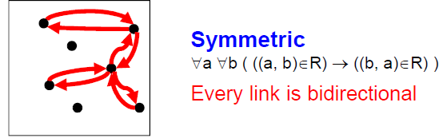
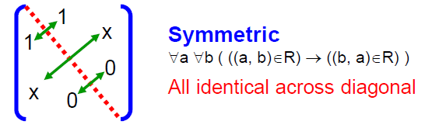
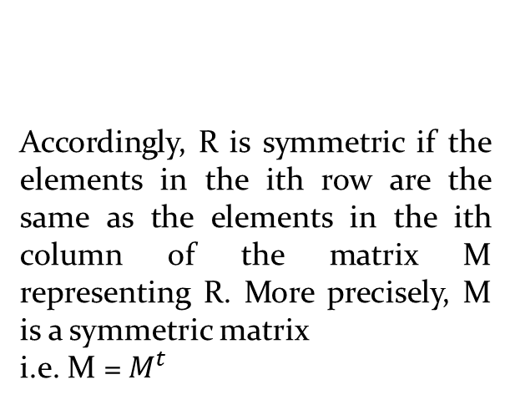
Symmetric Relations
Definition: R is symmetric iff (b,a) ∊ R whenever (a,b) ∊ R for all a,b ∊ A. Written symbolically, R is symmetric if and only if
∀a∀b [(a,b) ∊R ⟶ (b,a) ∊ R]
More precisely, M is a
symmetric matrix i.e. M = Mt
Accordingly, R is symmetric if the elements in the ith row are the same as the elements in the ith column of the matrix M representing R. More precisely, M is a symmetric matrix
i.e. M = $M^{t}$

Slide 26
Symmetric Relations
EXAMPLE: Let A = {1, 2, 3, 4} and determine whether relations R1, R2, R3, and R4 are Symmetric?
R1 = {(1, 1), (1, 3), (2, 4), (3, 1), (4,2)}
R2 = {(1, 1), (2, 2), (3, 3), (4, 4)}
R3 = {(2, 2), (2, 3), (3, 4)}
R4 = {(1, 1), (2, 2), (3, 3), (4, 3), (4, 4)}
Solution:
R1 is Symmetric, since (a, b) and (b, a) ∈R1 for all (a, b) ∈A.
R2 is also symmetric. We say it is vacuously true.
R3 is not symmetric, because (2,3) ∈ R3 but (3,2) ∉ R3.
R4 is not symmetric because (4,3) ∈ R4 but (3,4) ∉ R4.

Slide 27
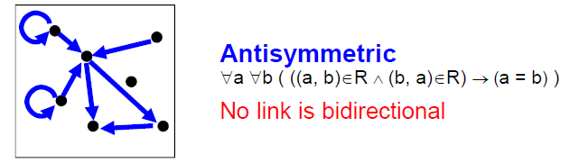
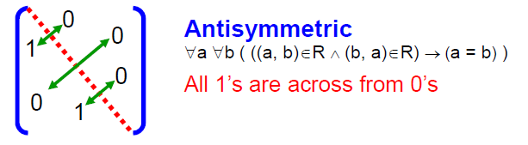
Antisymmetric Relations
Definition: A relation R on a set A such that for all a,b ∊ A if (a,b) ∊ R and (b,a) ∊ R, then a = b is called antisymmetric. Written symbolically, R is antisymmetric if and only if ∀a∀b [(a,b) ∊R ∧ (b,a) ∊ R ⟶ a = b]
Note: (a,a) may be an element in R.
Let R be an anti-symmetric relation on a set A = {a1, a2, …, an}. Then if (ai, aj) ∈R for
i ≠ j then (ai, aj) ∉R.
Thus in the matrix representation of R there is a 1 in the ith row and jth column
iff the jth row and ith column contains 0 vice versa.

Slide 28
Antisymmetric Relations
EXAMPLE: Let A = {1, 2, 3, 4} and determine whether relations R1, R2, R3, and R4 are Antisymmetric?
R1 = {(1,1),(2,2),(3,3)}
R2 = {(1,2),(2,2), (2,3), (3,4), (4,1)}
R3={(1,3),(2,2), (2,4), (3,1), (4,2)}
R4={(1,3),(2,4), (3,1), (4,3)}
Solution:
R1 is anti-symmetric and symmetric.
R2 is anti-symmetric but not symmetric because (1,2) ∈ R2 but (2,1) ∉ R2.
R3 is not anti-symmetric since (1,3) & (3,1) ∈ R3 but 1 ≠ 3. Note that R3 is symmetric.
R4 is neither anti-symmetric because (1,3) & (3,1) ∈ R4 but 1 ≠ 3 nor symmetric because (2,4) ∈ R4 but (4,2) ∉R4.

Slide 29
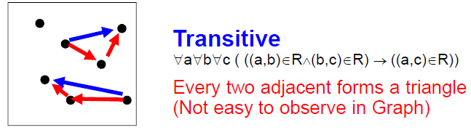
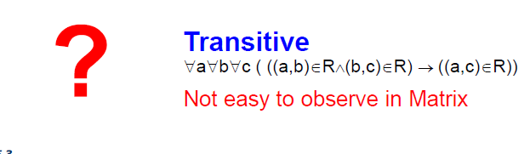
Transitive Relations
Definition: A relation R on a set A is called transitive if whenever (a,b) ∊ R and (b,c) ∊ R, then (a,c) ∊ R, for all a,b,c ∊ A. Written symbolically, R is transitive if and only if
∀a∀b ∀c[(a,b) ∊R ∧ (b,c) ∊ R ⟶ (a,c) ∊ R ]
For a transitive directed graph, whenever there is an arrow going from one point
to the second, and from the second to the third, there is an arrow going directly from the
first to the third.

Slide 30
Transitive Relations
EXAMPLE: Let A = {1, 2, 3, 4} and determine whether relations R1, R2 and R3 are Transitive?
R1 = {(1, 1), (1, 2), (1, 3), (2, 3)}
R2 = {(1, 2), (1, 4), (2, 3), (3, 4)}
R3 = {(2, 1), (2, 4), (2, 3), (3,4)}
Solution:
R1 is transitive because (1, 1), (1, 2) are in R, then to be transitive relation(1,2) must be there and it belongs to R.
R2 is not transitive since (1,2) and (2,3) ∈ R2 but (1,3) ∉ R2.
R3 is transitive.(check by definition)

Slide 31
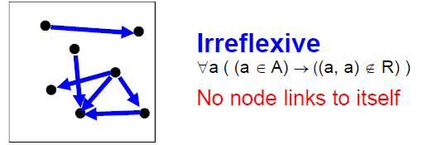
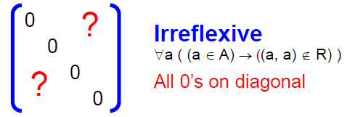
Irreflexive Relations
Definition: R is irreflexive iff for all a∈A,(a,a) ∉R. That is, R is irreflexive if no element in A is related to itself by R.
Written symbolically, R is irreflexive if and only if
∀a [(a ∊A) ⟶ (a , a)∉ R]
R is not irreflexive iff there is an element a∈A such that (a,a) ∈R.

Slide 32
Irreflexive Relations
EXAMPLE: Let A = {1, 2, 3, 4} and determine whether relations R1, R2 and R3 are Irreflexive?
R1 = {(1,3), (1,4), (2,3), (2,4), (3,1), (3,4)}
R2 = {(1,1), (1,2), (2,1), (2,2), (3,3), (4,4)}
R3= {(1,2), (2,3), (3,3), (3,4)}
Solution:
R1 is irreflexive since no element of A is related to itself in R1. i.e. (1,1)∉ R1, (2,2) ∉ R1, (3,3) ∉ R1,(4,4) ∉ R1.
R2 is not irreflexive, since all elements of A are related to themselves in R2.
R3 is not irreflexive since (3,3) ∈R3. Note that R3 is not reflexive.

Slide 33
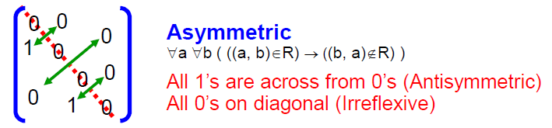
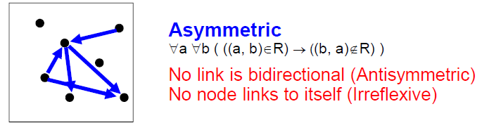
Asymmetric Relations
Definition: R is Asymmetric iff for all (a,b) ∊R than (b ,a)∉R. Written symbolically, R is Asymmetric if and only if
∀a ∀b[((a,b) ∊R)) ⟶ ((b , a)∉ R)]
Note:(a,a) cannot be an element in R.
Asymmetry = Antisymmetry + Irreflexivity

Slide 34
Asymmetric Relations
EXAMPLE: Let A = {1, 2, 3, 4} and determine whether relations R1, R2 and R3 are Asymmetric?
R1 = {(1,1), (1,2), (2,1), (2,2), (3,4), (4,1), (4,4)}
R2 = {(1,2),(2,3),(3,4)}
R3 = {(2,3),(3,3),(3,4)}
Solution:
R1 is not Asymmetric since R1 is neither Antisymmetric nor Irreflexive.
R2 is Asymmetric since R2 is both Antisymmetric and Irreflexive.
R3 is not Asymmetric since it is Antisymmetric but not irreflexive.

